Slide 1
In an accident!? Now what?
Creating a plan for drivers and responders

Slide 2
What’s required?
UDOT Reporting
Determine what type of accident
What to Report
Report via RPT online system

Slide 3
Determining the type of accident
The UDOT Rural Public Transit State Management Plan defines 2 types of accident;
Serious Accident
Minor Accident
Determine what type
Type Definitions
What to Report
Report via RPT online System

Slide 4
Accident Type Definitions
Fatal Injury Damage ≥$25,000, Vehicle(s) towed from scene Must report through NTD
Serious
Minor Injuries Damage < $25,000 Drivable vehicle(s)
Minor
https://drive.google.com/file/d/1kdzJxwna42oJ166BJSUW8sxzj7CORDWC/view
Also available on URSTA website > Resources
Type Definitions
Determine what type
What to Report
Report via RPT online System

Slide 5
What do we need to report?
Date of occurrence
Time of occurrence
Location of occurrence
Description of occurrence
Copies of witness reports
Number of fatalities (N/A in minor accident)
Number of injured persons
Extent of injuries
Extent of damages
Photos of damage
Copy of police report
Copy of insurance info
Drug and alcohol test report
What to Report
Determine what type
Type Definitions
Report via RPT online system

Slide 6
Reporting via RPT online system
Reporting in the RPT online system for either type of accident will send email alert to the UDOT Compliance Officer and the RPT Program Manager.
https://www.udot.utah.gov/connect/business/public-entities/rural-public-transit-team/
Report via RPT online System
Determine what type
Type Definitions
What to Report

Slide 7
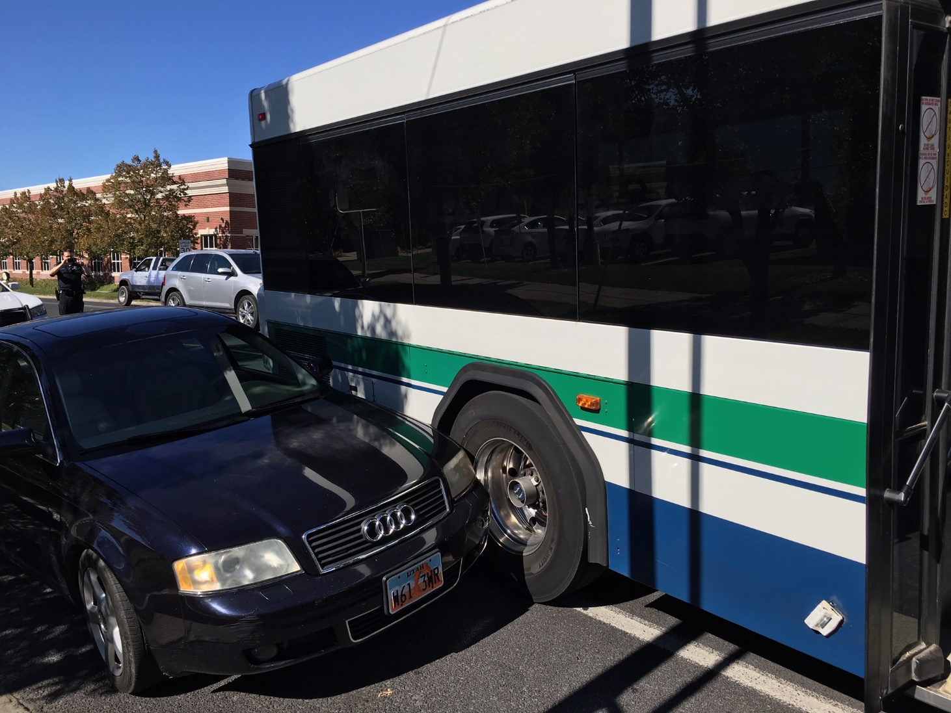
CREATE A PLAN FOR DRIVERS AND RESONDERS
Be Prepared!
Make it easily accessible
Make it easy to follow
Provide training
Create step by step instruction

Slide 8
Make it easily accessible Keep a kit, with ALL required documentation, in each vehicle OR Distribute to drivers at check in

Slide 9
Create Step by Step Instruction for DRIVERS based on your entity’s resources
Drivers are the front line, they must
Evaluate damage
Assess injuries
Communicate & Document
Provide resources that will take the guesswork out of what they need to do
and provide regular training and review

Slide 10
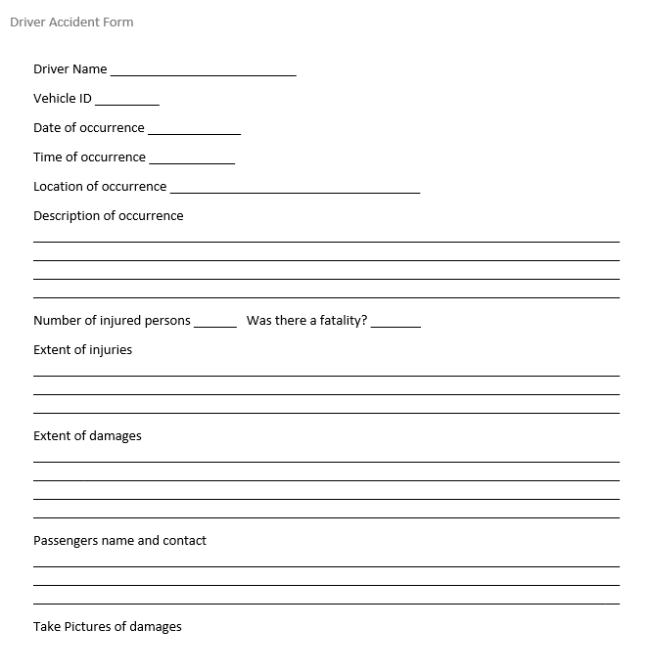
Examples of Driver Forms

Slide 11
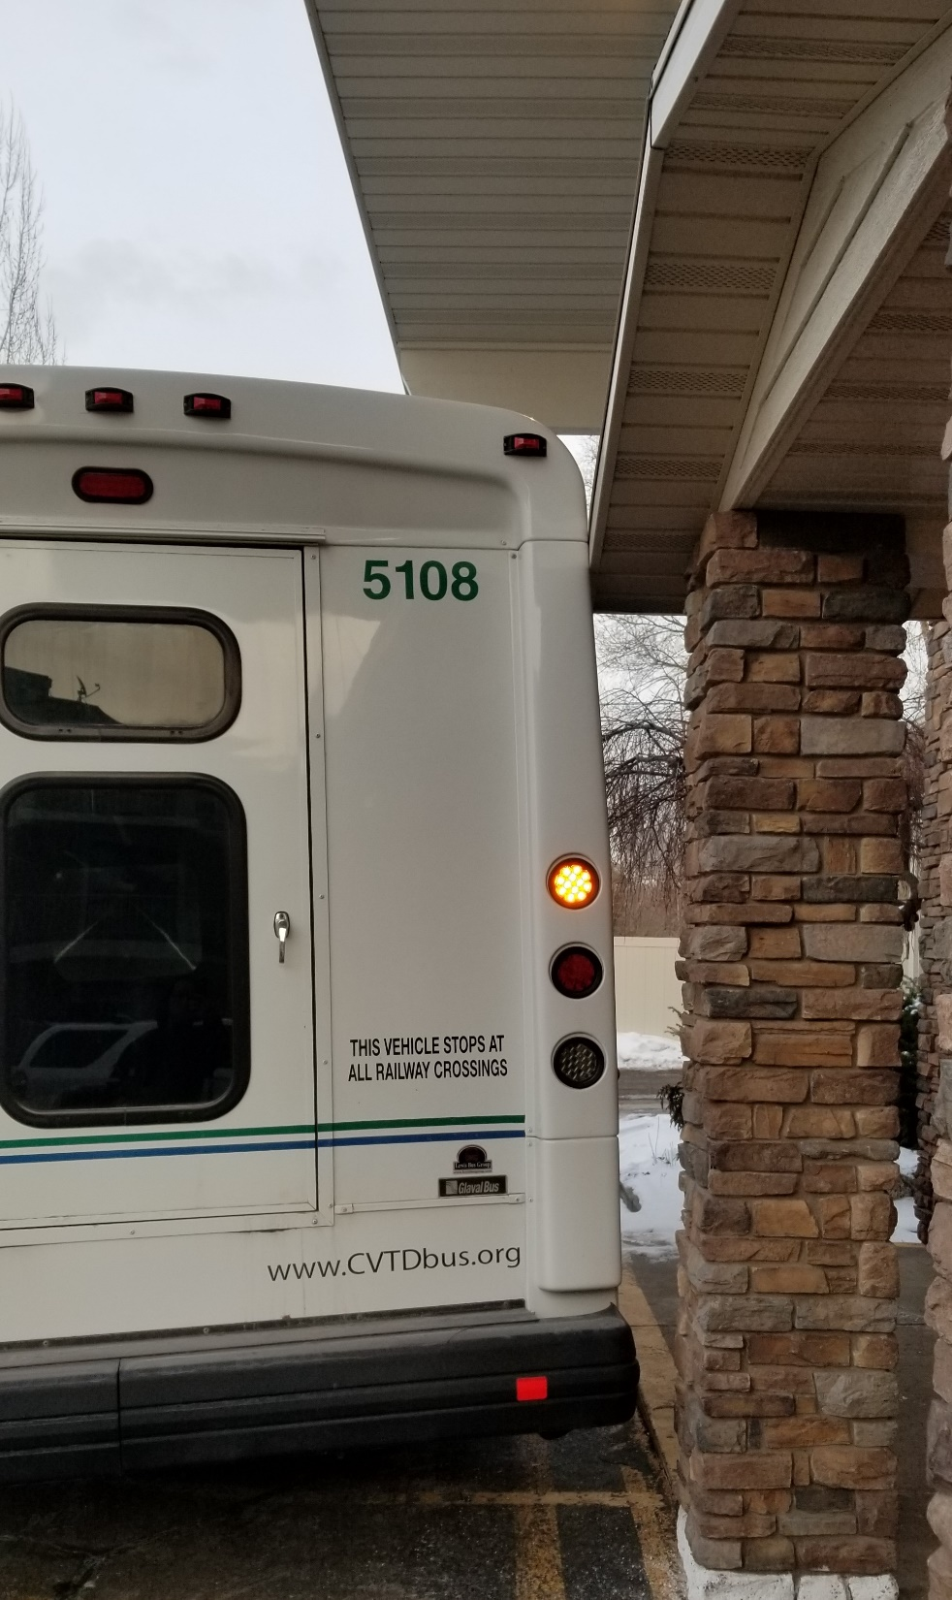
Dispatchers
Must maintain calm
Provide support for the driver
Communicate clearly between driver and supervisor
Accurate Documentation
Create easy to follow instruction

Slide 12
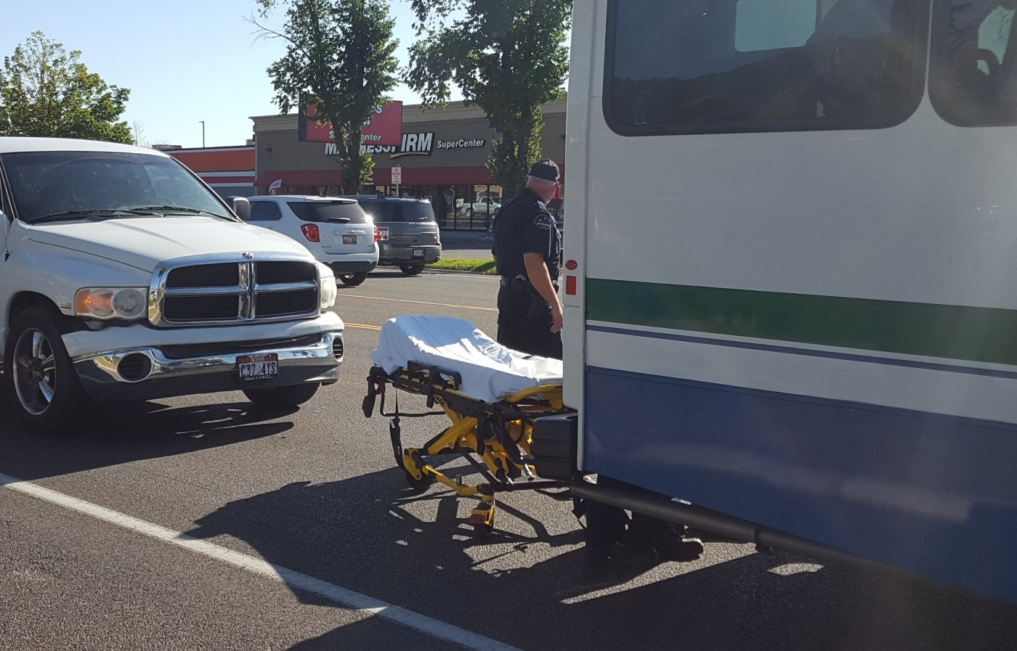
Dispatch Form
Everything in one place
Info for communicating with public dispatch / law enforcement
Contact info provided for responders
Info to help driver
Expected documentation outlined

Slide 13
Responder
Assist driver with completion of all documentation
Work with law enforcement and insurance (as needed)
Determine vehicle driveability
Determine need for drug/alcohol test
Communicate needs with dispatch
Take photos
Review and report (depending on your entity)

Slide 14
Initial observations

Slide 15
Does this require a drug test?
The FTA provides post accident drug test cards for free on FTA website.
https://transit-safety.fta.dot.gov/DrugAndAlcohol/Publications/DocumentInfo.aspx?DocID=440

Slide 16
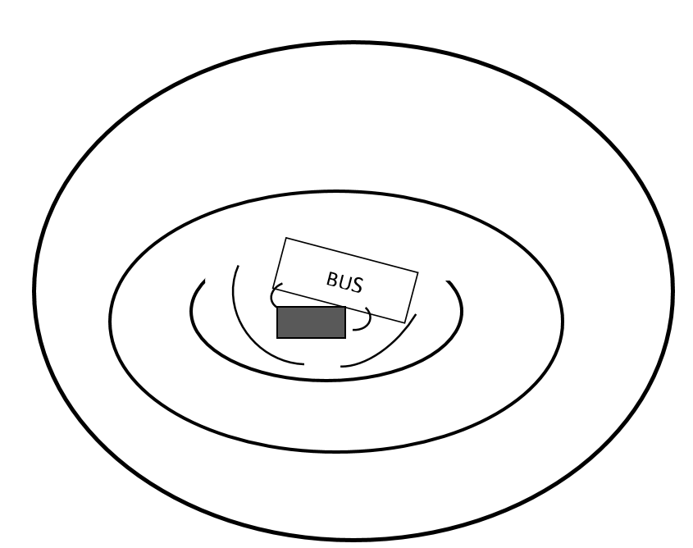
Photos help insurance claims, recreate the scene!.
360 ⁰ distant perimeter
Providing context of location, traffic, etc.
Don’t use zoom features or context may be lost
Take multiples, getting closer each time
Take more than you think you need
It’s easier to withhold unnecessary pics than to go back in time to get the ones you missed
Remember to get detailed pics of damage

Slide 17
Responder Checklist
Step by step
Gathers documents from Driver and Dispatcher
Ensures that all required information is completed
Information used for reporting to RPT and NTD as needed

Slide 18
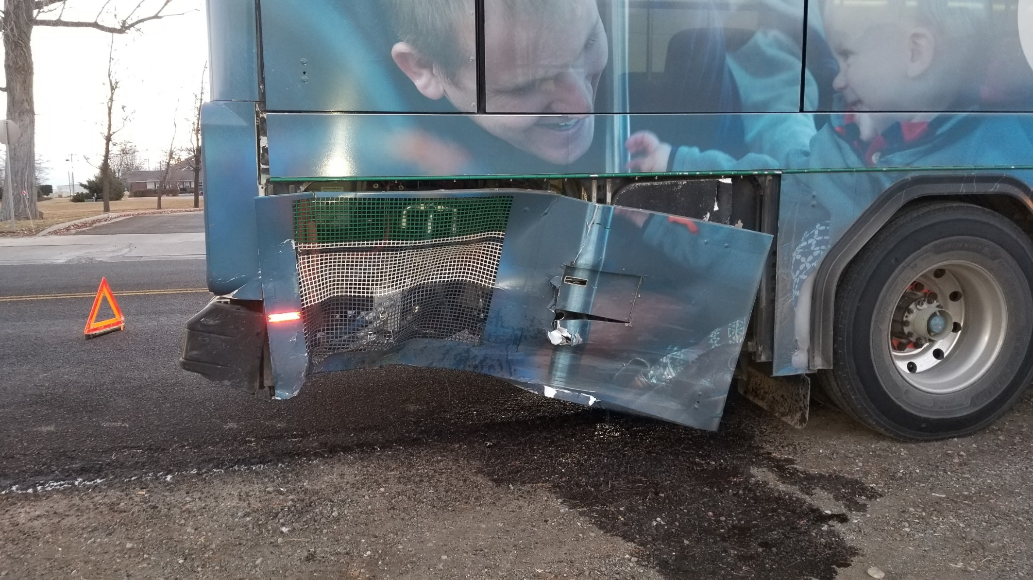
Creating checklists can provide
Clear direction based on position and stewardship
More accurate reporting information
Completed in timely manner
Documentation that is easier to review and assess
Better for insurance claims

